Slide 1
Heat Transfer Activating Strategy
Watch the videos below or do the activities in class. Ask students to guess what cooks the popcorn in each example.
Popcorn Method 1:
http://www.youtube.com/watch?v=9UL1Mbo_tSw
Popcorn Method 2:
http://www.youtube.com/watch?v=cSoR8v4GT5I
Popcorn Method 3:
http://www.youtube.com/watch?v=_HGIkNLBcWY
Notes:
Instructional Approach(s): The teacher should use the slide to activate students prior knowledge. The teacher can click on the links and pose the question to the class, individual students, or let the students pair up to answer the questions. The teacher should not spend more than 5 minutes on the slide.

Slide 2
Essential Question: How does energy move from one object to another?
Standard:
S8P2d. Describe how heat can be transferred through matter by the collisions of atoms (conduction) or through space (radiation). In a liquid or gas, currents will facilitate the transfer of heat (convection).
Notes:
Instructional Approach(s): The teacher should introduce the essential question and the standard that aligns to the essential question

Slide 3
Use the Types of Heat Transfer Foldable to take notes
Notes:
Instructional Approach(s): The teacher should give each student the Types of Heat Notes sheet [linked on the resource page] to use to record important information throughout the lesson

Slide 4
Reviewing Heat (Thermal) Energy
Heat (thermal) energy is created by the movement of particles (atoms) that produces heat.
Heat (thermal) energy increases as temperature increases because as temperature increases, atoms move faster (have more kinetic energy)
http://www.middleschoolchemistry.com/multimedia/chapter1/lesson2#heating_and_cooling
Notes:
Instructional Approach(s): The teacher should show the short video to review thermal energy.

Slide 5
Transfer of Heat (Thermal) Energy
Heat (thermal energy) is transferred from one object to another when the objects are at different temperatures.
The amount of heat (thermal energy) that is transferred when two objects are brought into contact depends on the difference in temperature between the objects.
Notes:
Instructional Approach(s): The teacher should present the information on the slide while the students record the important information on their notes

Slide 6
Transfer of Heat (Thermal) Energy
Heat is transferred only when two objects are at different temperatures
Thermal energy always moves from warmer to cooler objects
The warmer object loses thermal energy and becomes cooler as the cooler object gains thermal energy and becomes warmer.
Energy will continue to move from a warmer object to a cooler object until both have the same temperature.
Notes:
Instructional Approach(s): The teacher should present the information on the slide while the students record the important information on their notes

Slide 7
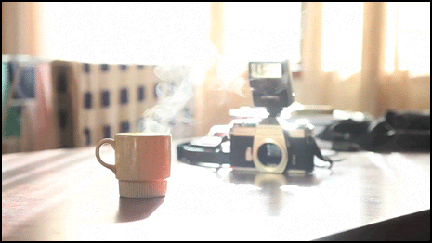
What will happen to the coffee as it continues to sit?
Notes:
Instructional Approach(s): The teacher should present the illustration to provide an example of heat transfer. The teacher should ask the class or call on students to answer the question.

Slide 8
Heat Transfer can occur in three ways:
Conduction
Convection
Radiation
Notes:
Instructional Approach(s): The teacher should present the information on the slide.

Slide 9
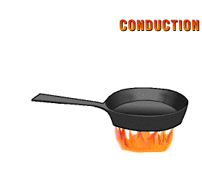
Conduction
Conduction is the transfer of heat by direct contact (particles collide)
Conduction occurs most easily in solids and liquids
Notes:
Instructional Approach(s): The teacher should present the information on the slide while the students record the important information on their notes

Slide 10
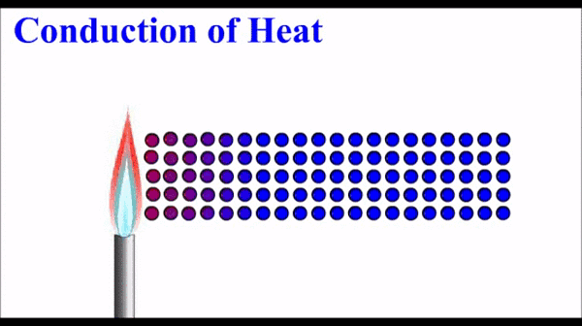
Conduction
Why is conduction easier in solids and liquids?
Atoms and molecules are closer together in solids and liquids. So, the particles need to move only a short distance before they bump into one another and transfer energy.
Notes:
Instructional Approach(s): The teacher should present the information on the slide while the students record the important information on their notes

Slide 11
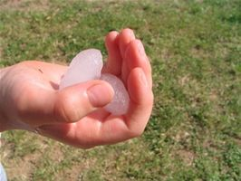
Explain the movement of thermal energy in the picture below.
Notes:
Instructional Approach(s): The teacher should present the illustration to provide an example of conduction. The teacher should ask the class or call on students to answer the question. Click the mouse to reveal the answer.

Slide 12
Faster moving molecules in your warm hand bump against the slower moving molecules in the ice. Thermal energy moves from your warmer hand to the colder ice. The slow moving molecules in the ice move faster.
Notes:
Instructional Approach(s): The teacher should present the illustration to provide an example of conduction. The teacher should ask the class or call on students to answer the question. Do not spend more than 3-5 minutes total time allowing for discussion. When ready, move the next slides to discuss the answer.

Slide 13
How is this an example of Conduction?
Faster moving molecules in your warm hand bump against the slower moving molecules in the ice to transfer thermal energy. Direct contact of the particles occurs; therefore, heat is transferred by Conduction.
Notes:
Instructional Approach(s): The teacher should present the illustration to provide an example of conduction. The teacher should ask the class or call on students to answer the question. Click the mouse to reveal the answer.

Slide 14
Conduction
Animation:
http://www.passmyexams.co.uk/GCSE/physics/conduction-heat-transfer.html
Eureka Video clip:
http://www.youtube.com/watch?v=Yitiw6Y7xZg
Notes:
Instructional Approach(s): The teacher should use the links on the slide to illustrate examples of conduction.

Slide 15
Your turn…Explain the movement of thermal energy if you were about to eat the Chinese food below. How is this an example of Conduction?
Notes:
Instructional Approach(s): This could be used as a formative assessment item to see if the students are grasping the concept

Slide 16
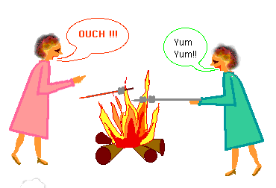
Why does the lady in the pink dress drop her roasting stick before the lady in the green dress?
Notes:
Instructional Approach(s): The teacher should present the illustration. The teacher should ask the class or call on students to answer the question.

Slide 17
Conductors and Insulators
Substances that transfer thermal energy very well are called Conductors.
Substances that do not transfer thermal energy very well are called Insulators.
Notes:
Instructional Approach(s): The teacher should present the information on the slide while the students record the important information on their notes

Slide 18
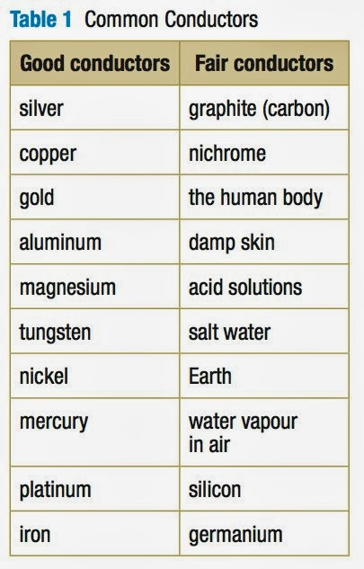
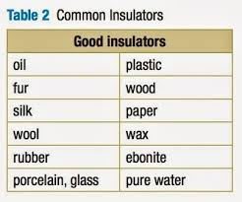
Conductors and Insulators
Notes:
Instructional Approach(s): The teacher should present the information on the slide.

Slide 19
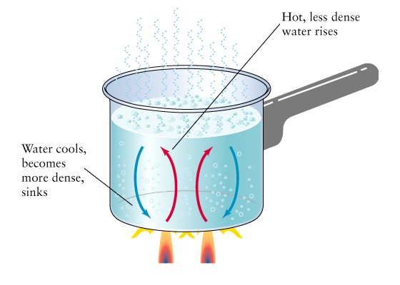
Convection
Convection is the flow of currents in a liquid or gas
A current is created when the warmer (less dense) material rises forcing the cooler (more dense) material to sink.
Notes:
Instructional Approach(s): The teacher should present the information on the slide while the students record the important information on their notes

Slide 20
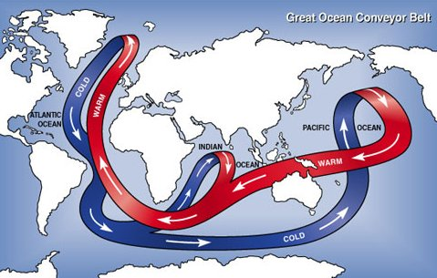
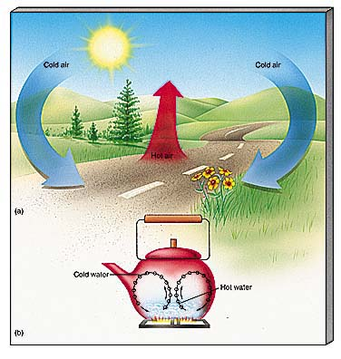
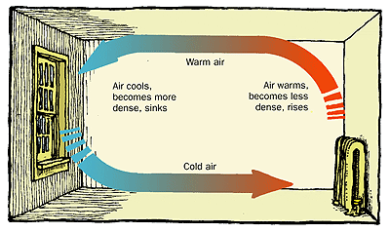
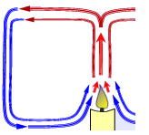
Everyday Examples of Convection Currents
http://www.healthyheating.com/Definitions/heat-transfer-convection.htm#.VD7SIfmjOSo
Notes:
Instructional Approach(s): Remind students that in the water cycle, warm air rises, cools and condenses. Students learned about convection currents and the water cycle in the 6th grade.

Slide 21
Animations and Video Clips
Convection
http://www.passmyexams.co.uk/GCSE/physics/convection-heat-transfer.html
Eureka Video clip:
http://www.youtube.com/watch?v=ON2Y3FEk_UI
Notes:
Instructional Approach(s): The teacher should use the links on the slide to illustrate examples of convection.

Slide 22
Describe an example of convection that you have experienced recently at home, at school, or outside.
Convection
Notes:
Instructional Approach(s): This could be used as a formative assessment tool.

Slide 23
What cooked the cookies?
How Hot was it? Dashboard Oven Hot
Notes:
Instructional Approach(s): This could be used as a formative assessment tool or as a classroom discussion.

Slide 24
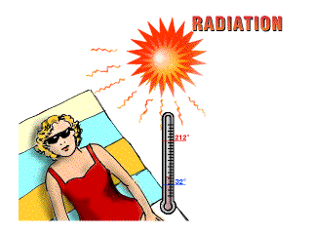
Radiation
Radiation is heat transfer through space by electromagnetic waves
Unlike Conduction and Convection, Radiation can occur in empty space, as well as in solids, liquids, and gases.
Waves such as visible light, infrared, and ultraviolet light are examples of radiation
Notes:
Instructional Approach(s): The teacher should present the information on the slide while the students record the important information on their notes

Slide 25
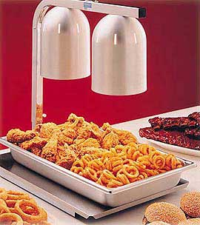
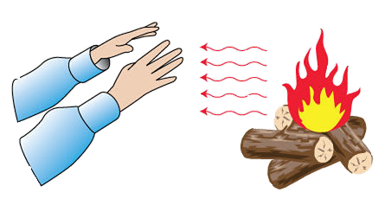
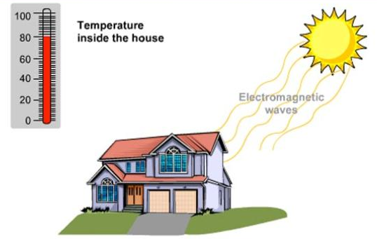
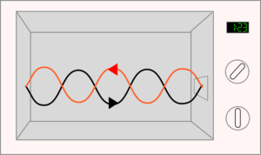
Radiation
Notes:
Instructional Approach(s): The teacher should use the images on the slide to illustrate examples of radiation.

Slide 26
Radiation
Eureka video clip:
http://www.youtube.com/watch?v=2JZciWtK6vc
Notes:
Instructional Approach(s): The teacher should use the link on the slide to illustrate examples of radiation.

Slide 27
Animations of Heat Transfer
http://www.pbslearningmedia.org/asset/lsps07_int_heattransfer/
https://www.e-education.psu.edu/egee102/node/2053 Scroll down for animations
Notes:
Instructional Approach(s): The teacher should present the links and animations to provide illustrations of heat transfer. The teacher should ask the class or call on students to recognize conduction, convection, and radiation.

Slide 28
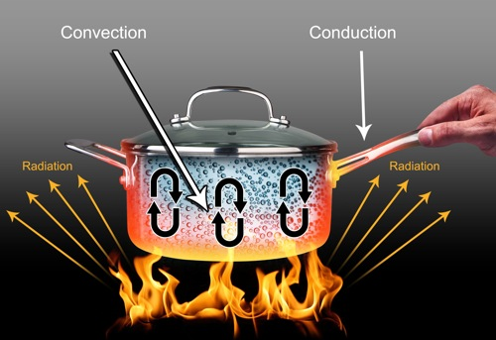
Look at the examples of Heat Transfer in the Image below
Notes:
Instructional Approach(s): The teacher should use the image to illustrate the types of heat transfer

Slide 29
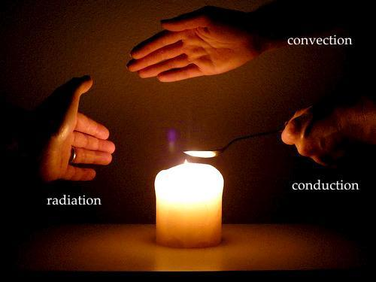
Look at the examples of Heat Transfer in the Image below
Notes:
Instructional Approach(s): The teacher should use the images on the slide to illustrate examples of conduction, convection, and radiation.

Slide 30
Heat Transfer Song
http://www.youtube.com/watch?v=wr8Z4SCETPs
Notes:
Instructional Approach(s): The teacher should show the heat transfer song video and use it reinforce the concepts of heat transfer

Slide 31
Look at the three images below. Identify which is an example of conduction, convection, and radiation.
A.
B.
C.
Notes:
Instructional Approach(s): The teacher should present the illustration. The teacher should ask the class or call on students to answer the question. Click the mouse to reveal the answer.

Slide 32
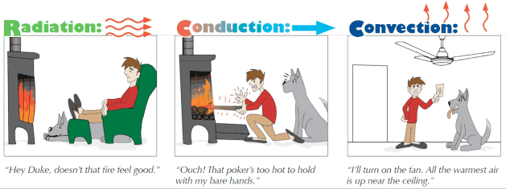
Look at the three images below. Identify which is an example of conduction, convection, and radiation.
Notes:
Instructional Approach(s): The teacher should present the illustration. The teacher should ask the class or call on students to answer the question. Click the mouse to reveal the answer.

Slide 33
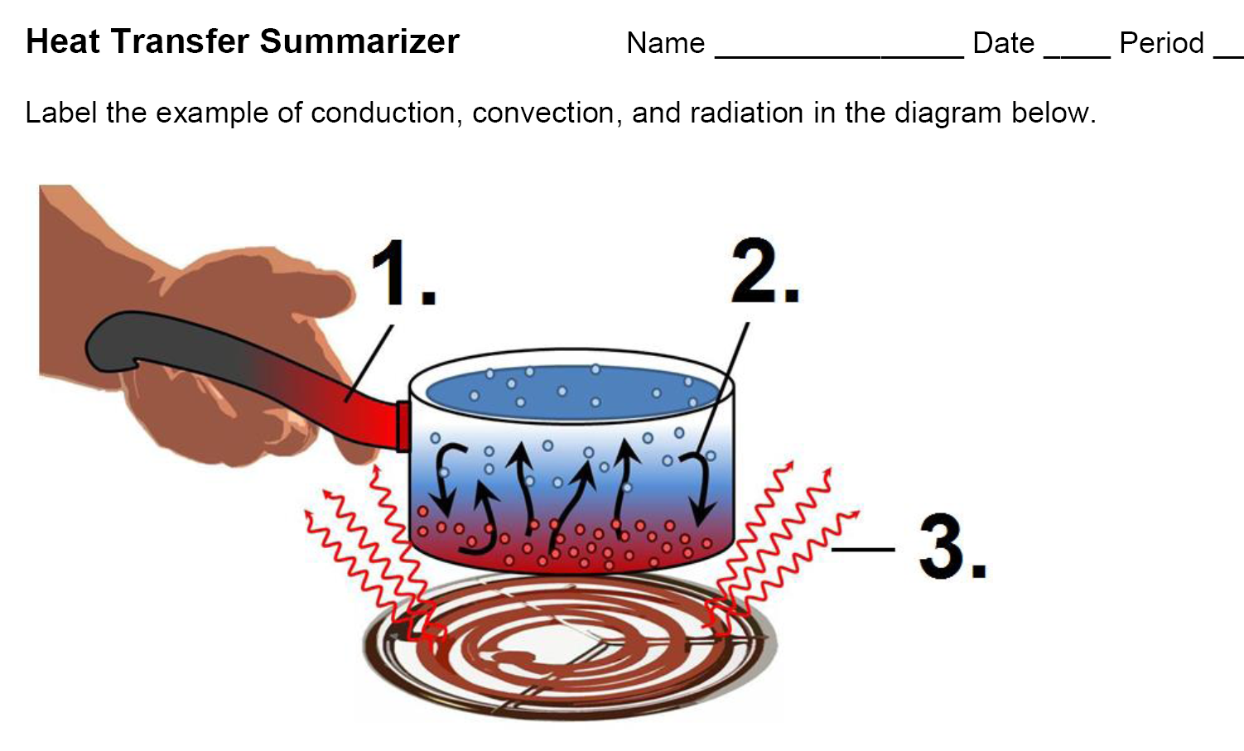
Heat Transfer Summarizer
Notes:
Instructional Approach(s): Instructional Approach(s): Each student should complete the summarizer. The teacher should use the summarizer to determine the level of student mastery and if differentiation is needed.

Slide 34
Heat Transfer Differentiation
[based on summarizer]
Notes:
Instructional Approach(s): The teacher should use the summarizer as a formative assessment to determine differentiation.

